Slide 1
Using a Regression Model to analyze NBA Statistics

Slide 2
Two Main Objectives of Regression Models
Establish if there exists a relationship between two or more variables.
--- More specifically, establish if there is a statistically significant relationship between the variables.
--- Examples: Income and spending, wage and gender, student height and exam scores.
Forecast new observations.
--- Can we use what we know about the relationship to forecast unobserved values?
--- Examples: What will our sales be over the next quarter? What will be the profitability of a new store?

Slide 3
Variable’s Roles
Dependent variable
--- This is the variable whose values we want to explain or forecast.
--- Its value depends on something else.
--- We denote it as Y.
Independent variable
--- This is the variable that affects the other one.
--- Its value is independent.
--- We denote it as X.

Slide 4
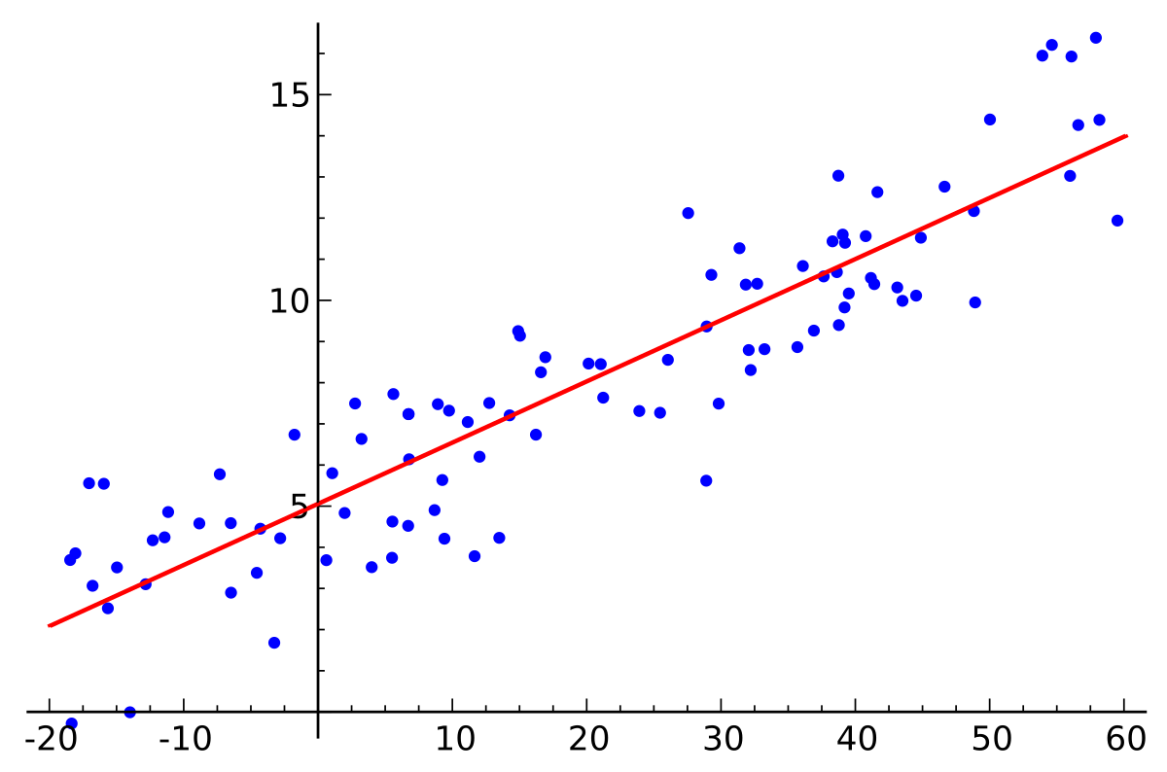

Simple Linear Regression
Use a linear equation to model the relationship between two variables.

Slide 5

Example: Consumption vs. Income
Most generally, the intercept may not have an intuitive interpretation.
Slope represents the sensitivity of the dependent variable on changes in the independent variable.
For every additional unit of income a family has, we estimate its consumption grows by 0.85 units.

Slide 6

Multiple Linear Regression
Use multiple predictor variables to make a prediction about one or more dependent variables.

Slide 7
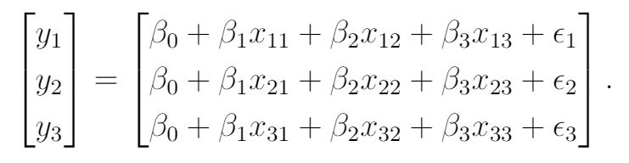
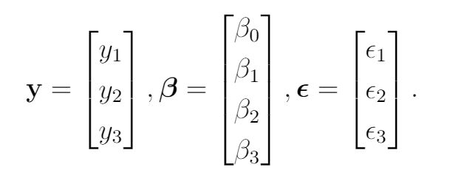
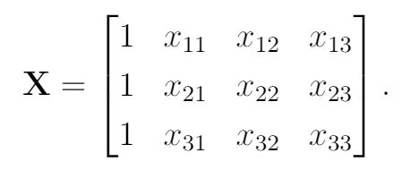

For multiple dependent variables, we use matrices to represent the model.
To write the equation more compactly:

Slide 8
Example: Analyzing how Turnovers and Shooting percentage affect total points scored
If a team increases turnovers by 1, we expect the number of points scored to decrease by 0.980.
For each 1% a team’s shooting percentage increases, we expect that team to score 2.522 more points.

Slide 9
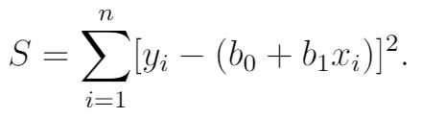

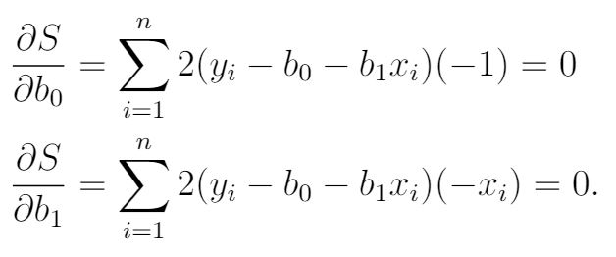
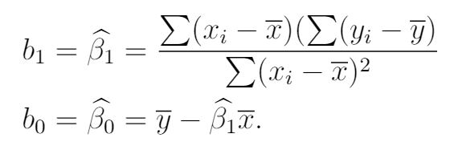
The method of Least Squares
Used to estimate parameters of a linear regression.

Slide 10
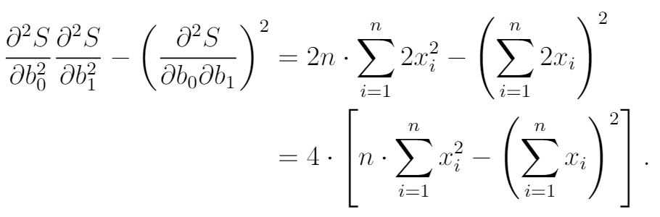
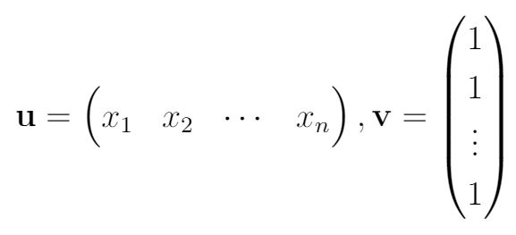
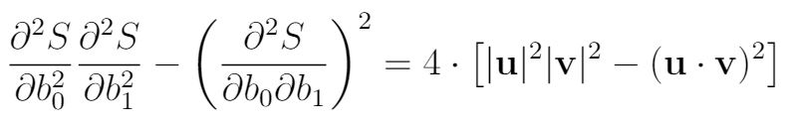


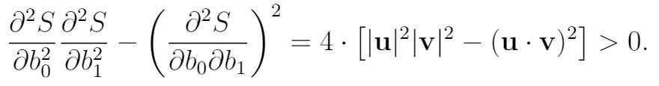
To make sure the critical point is not a saddle:

Slide 11
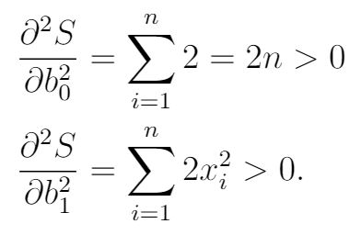


To make sure the critical point is a minimum:
Therefore our least square estimates are:
For multiple linear regression:

Slide 12
Examples of Binary Outcomes
Should a bank give a person a loan or not?
Is a particular student is admitted into a school?
Is a person voting against a new law?

Slide 13
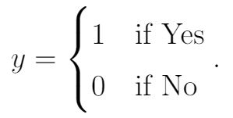

Representing the Binary Outcomes
There are two outcomes: Yes and No
We will create a dummy variable to indicate if an observation is Yes or No:
Example: Analyzing how age influences customers’ subscription to a magazine
Every additional year of age increases the probability of subscription by 6.4%.

Slide 14
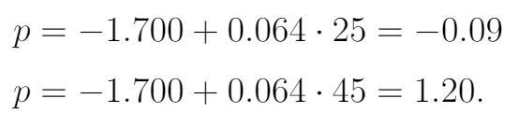
Problem of this linear model
Try to predict the probabilities for 25 and 45 years of age:
By the definition of the probability, any probability needs to stay between 0 and 1.

Slide 15
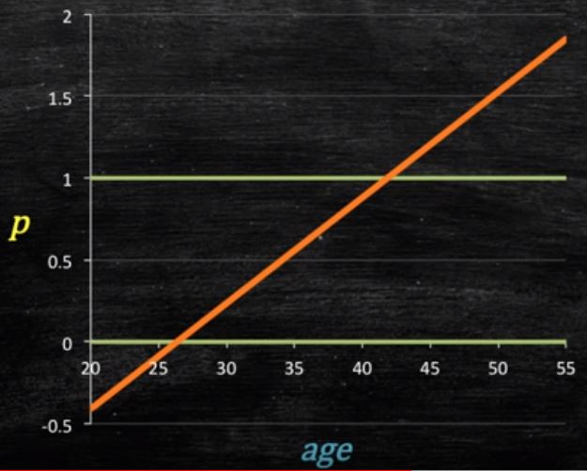
When below 26 years of age or so, the estimated probabilities are negative.
When above 44 years of age or so, the probabilities are greater than 1.

Slide 16

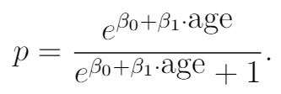
Fixing the prior Approach (2 steps)
First, the probability must always be positive. An exponential form would satisfy this.
Second, the probability must be at most 1. Thus we propose to use the expression we had before, and divided by something that is slightly larger, say 1.

Slide 17
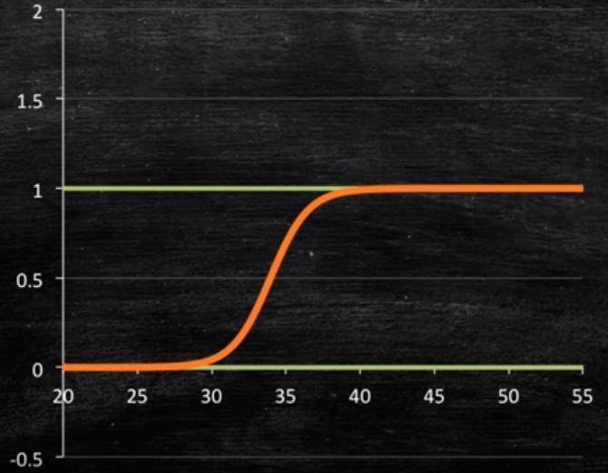
As customers grows older, the probability asymptotically gets closer to 1.
When the age approaches to the other direction, the function is asymptotically closer to 0.

Slide 18
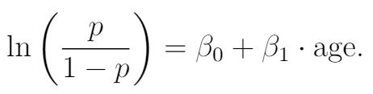
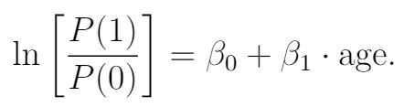
Log-linear modeling
Even if the probability of a customer subscribing is not a linear function of age, we can perform a simple transformation on it such that it is now a linear function of age.
The natural log of the ratio of probabilities of 2 outcomes is called a log odd. This is why we must add a 1 to the denominator for a binary logistic model.

Slide 19
Quantitative vs. Categorical variables
Quantitative variables
--- have numerical values
--- Examples: age, income, height
Categorical variables
--- variables that fall into categories
--- For categories of hair color, some categorical variables would be black, red, brown.

Slide 20
Ordered vs. Unordered categorical variables
Ordered categorical variables
--- need to define a factor X as our response
--- Example: Strongly agree, Agree, Neutral, Disagree, Strongly disagree
Unordered categorical variables
--- If there are N unordered categorical variables, there will be N-1 log odds.
--- Example: Mathematics, Engineering, History, Art
Whether or not we want to order categorical variables depends on what we are trying to model.

Slide 21
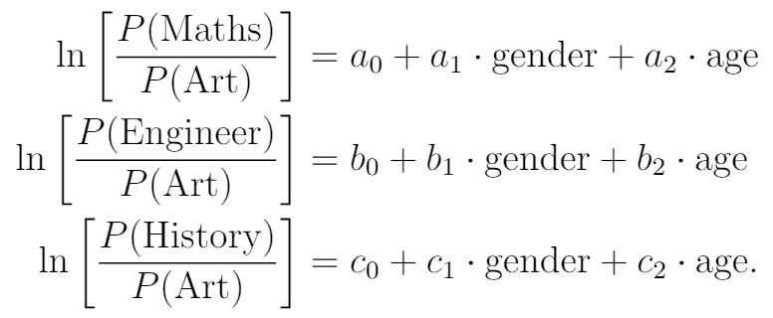
Multinomial logistic regression
Model unordered categorical dependent variables which takes more than 2 categories.
Example: Analyze how gender and age affect students’ choice of major.
Assume that there are 4 categories: Mathematics, Engineering, History, Art
Define “Art” as our base category, thus we have 3 log odds.

Slide 22
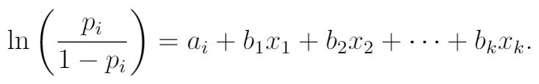
Ordinal Logistic Regression
Used to model more than two ordered categorical variables.
The key is to predict the partitions of several outcomes.
Example: Analyze whether a symptom is mild, moderate or severe.
p_{i} represents the probabilities of outcome less or equal to i
a_{i} represents the intercept for an outcome less or equal to i

Slide 23
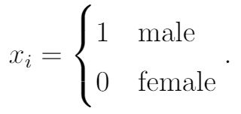

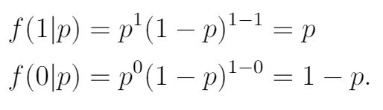
Maximum Likelihood Estimation (MLE)
A method to estimate the parameters of logistic regressions.
Example: Estimate the probability that a given U.S. individual is male
Suppose there is a sample of N individuals from U.S.
Define the probability density function (PDF):

Slide 24
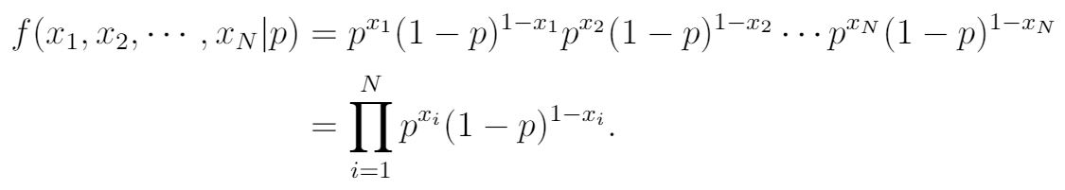
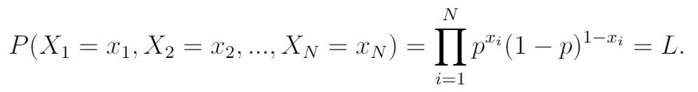
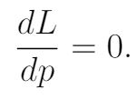
Add more supplemental observations:
Define some random variables, each of them represents the sex of a individual:

Slide 25
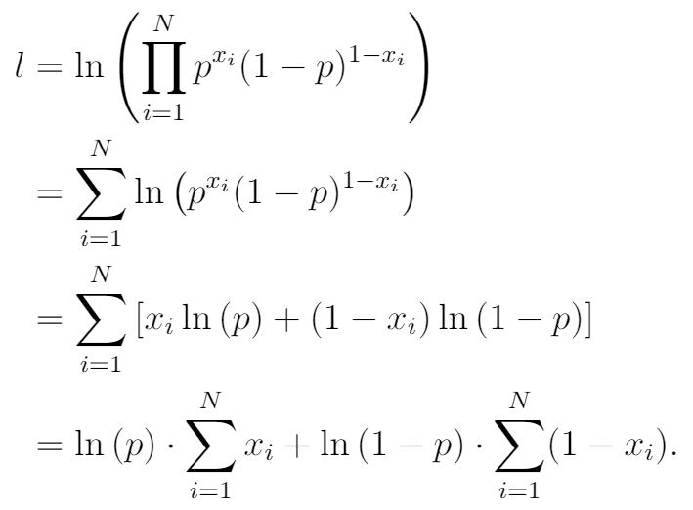
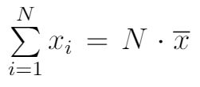

Log likelihood:

Slide 26
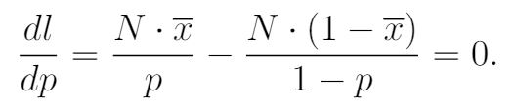
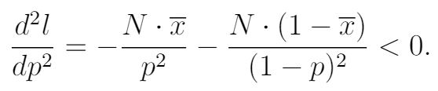

Find the critical point:
To make sure the critical point is a maximum:
The answer also maximizes the likelihood function since log function is monotonic:

Slide 27
Case Study: NBA playoff results estimation
I used an ordinal logistic regression model.
I used the following data of regular season taken from basketball-reference.com to estimate playoff results:
--- regular season total win rate (W/L%)
--- points scored per game (PS/G)
--- points allowed per game (PA/G)
--- regular season matching result between the two teams (net-wins)

Slide 28
Dataset (260 series)
Rule change: 3-point line extension in 1997-98 season
The first rounds of NBA playoffs were not best-of-7 series until 2002-03 season.
There are 15 series in each season: 1+2+4+8=15
7*5 + 15*15 = 260

Slide 29
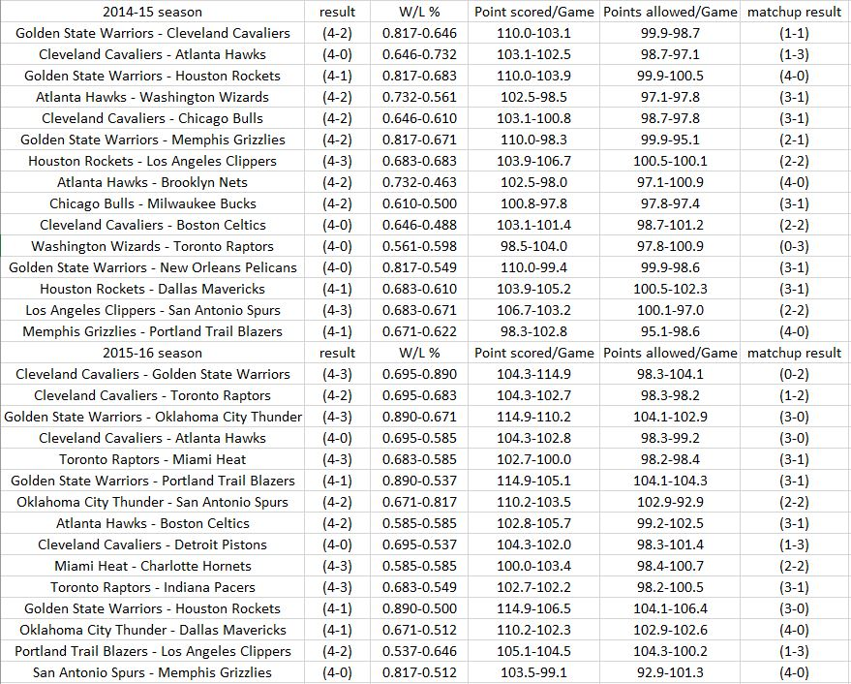

Slide 30
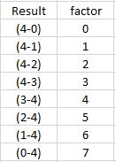
Modifications to my dataset
1. All independent variables (predictors) should be numbers, so I calculated the differences of all predictors.
2. The original dataset was ordered by the winners first, so I flipped half of the 4-0 series into 0-4, negating the 4 independent variables (predictors) at the same time. Then I performed the same operation to half of the 4-1, 4-2, 4-3 series.
3. Define an ordered factor X for all of our possible outcomes.

Slide 31
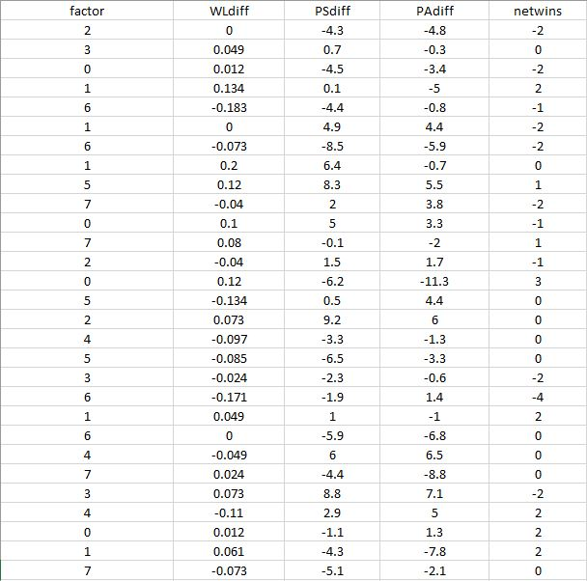

Slide 32
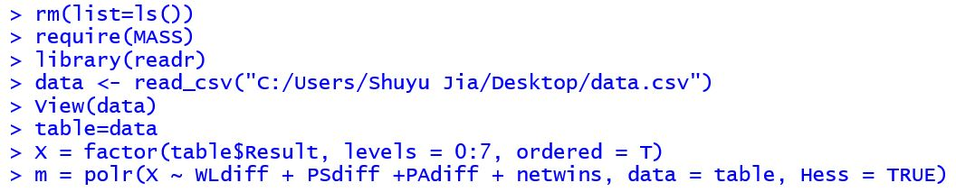
Simulation in R Studio
I fed in the data of the first 19 seasons to build the ordinal logistic regression model, and then test the model using the data of the last season.

Slide 33
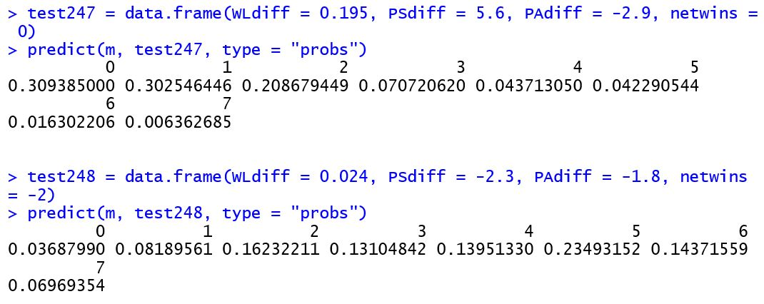
Testing results

Slide 34
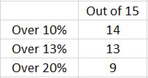
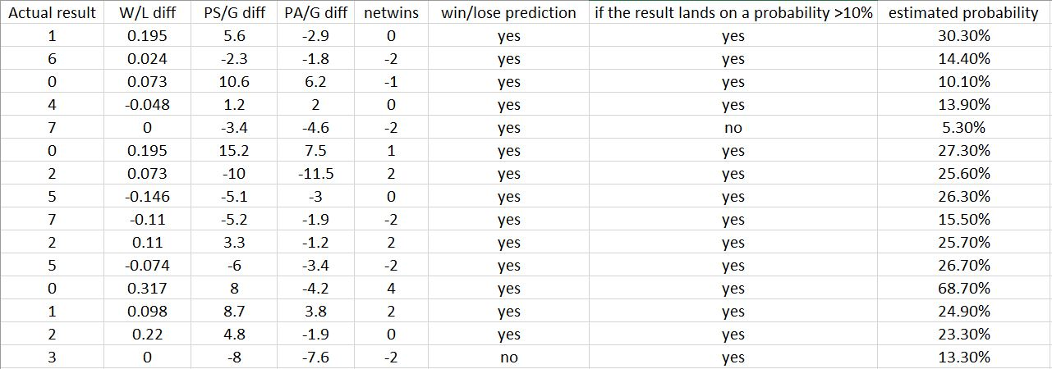
Test how the model performs
1. Predict which team is going to win the series
2. If the actual result lands on a simulated probability greater than 10%. 10% is an arbitrary value just to test how the model performs, and is not based on any metric.

Slide 35
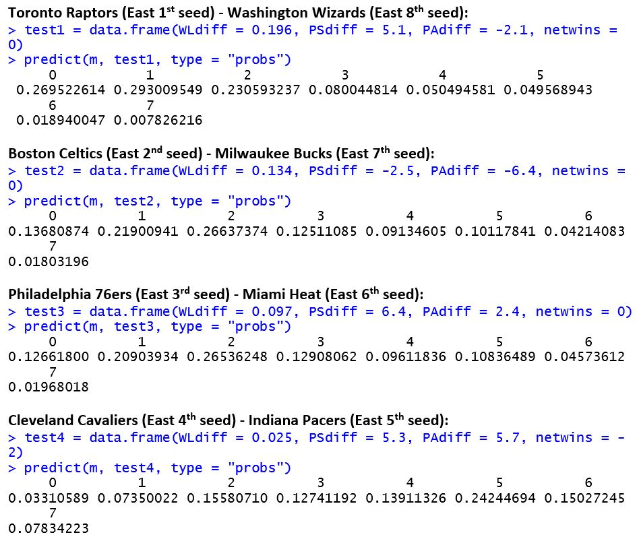
Prediction of this season’s playoff results (first round)

Slide 36
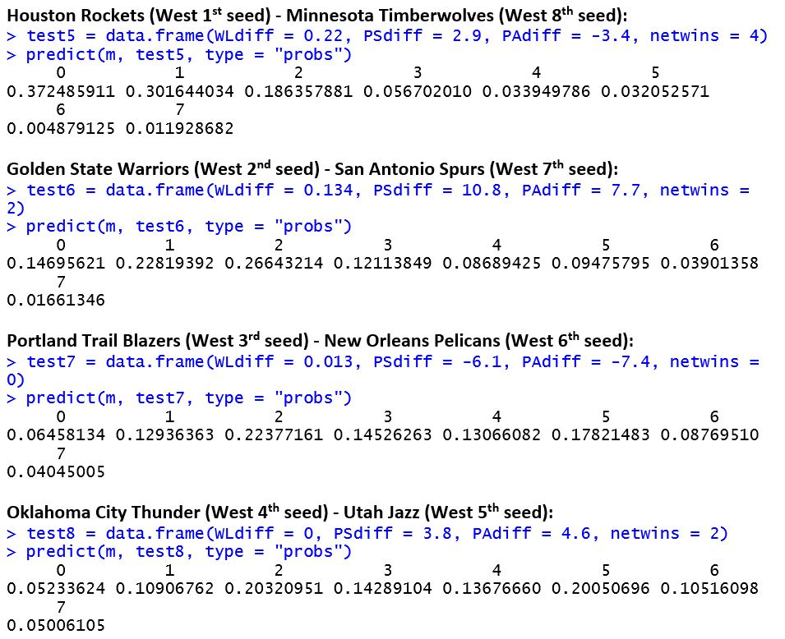

Slide 37
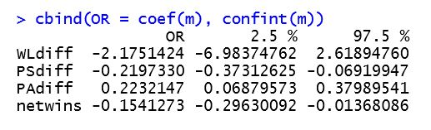
Importance of each predictor
If zero lies in the confidence interval of a coefficient, then the corresponding predictor is not significant.

Slide 38
Improvements
1. Use points differential instead of net-wins
2. Delete exceptional data

Slide 39
Questions?

Slide 40
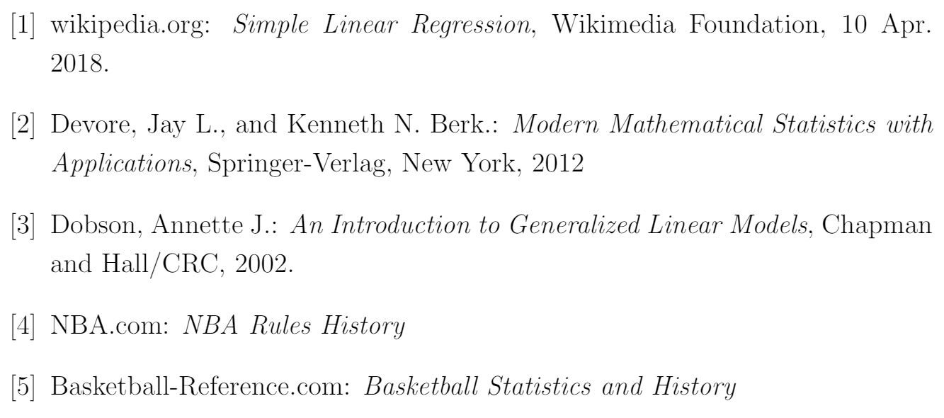
References

